Slide 1

Introduction to Nanopore Sequencing
Kirstyn Brunker
RAGE workshop, SCENE, University of Glasgow
26-30th June 2023

Slide 2
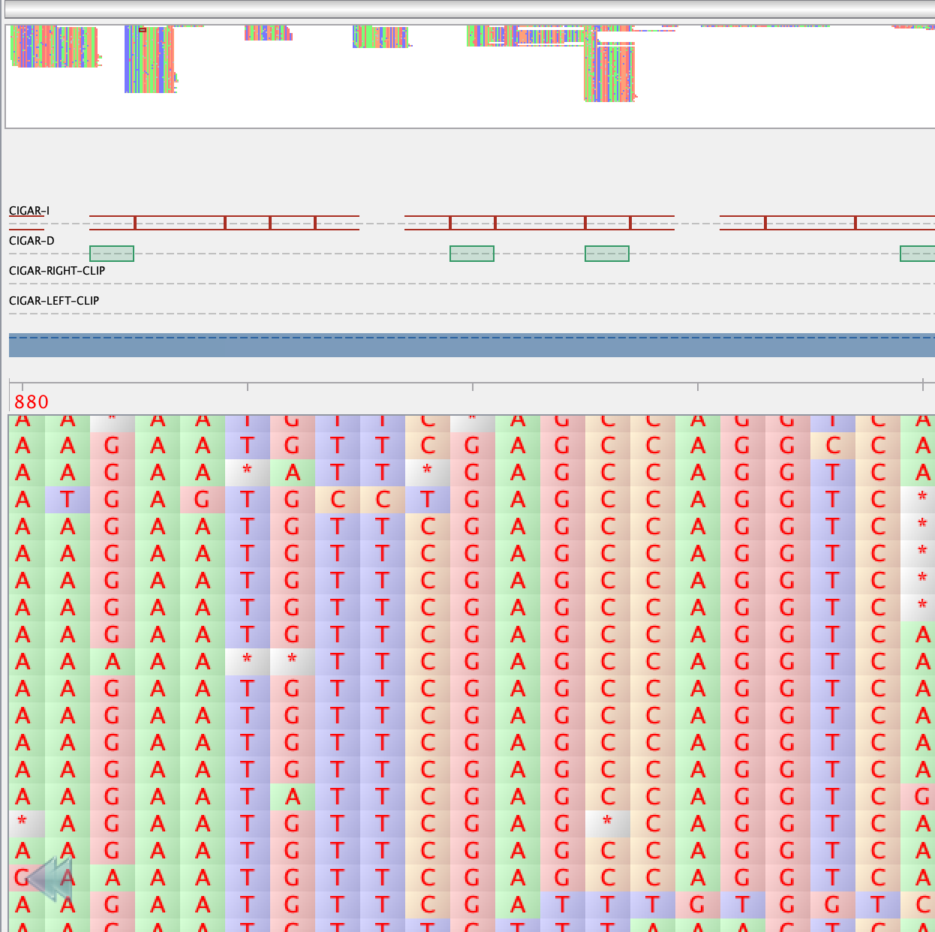
Next generation sequencing
Massively parallel sequencing technologies
Simultaneously sequence millions of DNA fragments
Notes:
Compared to sanger capillary-based method that typically sequences a single DNA fragment (reliable but low throughput)
Technologies: Illumina, PacBio, Nanopore, Ion Torrent

Slide 3
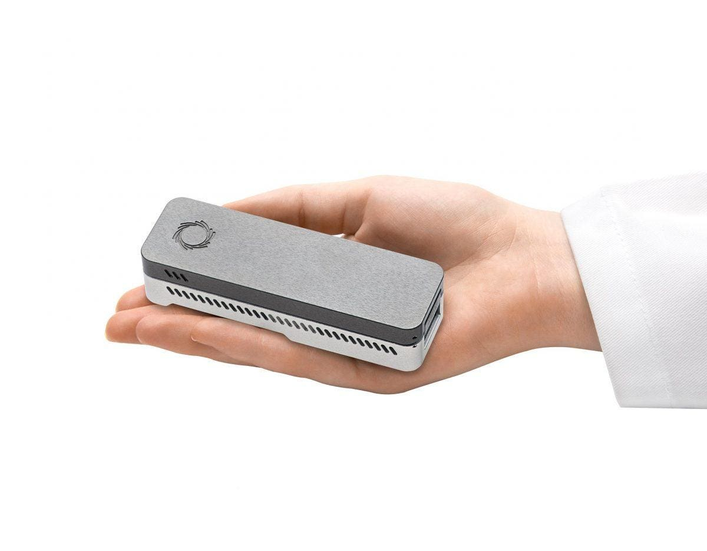
Nanopore sequencing
A unique, scalable technology that enables direct, real-time analysis of long DNA or RNA fragments
Notes:
Nanopore sequencing is a method of DNA sequencing that involves passing DNA strands through tiny nanopores and detecting changes in electrical current to determine the sequence of bases.

Slide 4


Disruptive technology
Enabling the analysis of anything, by anyone, anywhere
Notes:
Paradigm shift in biological analysis
Nanopore is refered to as 3rd/4th generation, characterized by read length capabilities

Slide 5
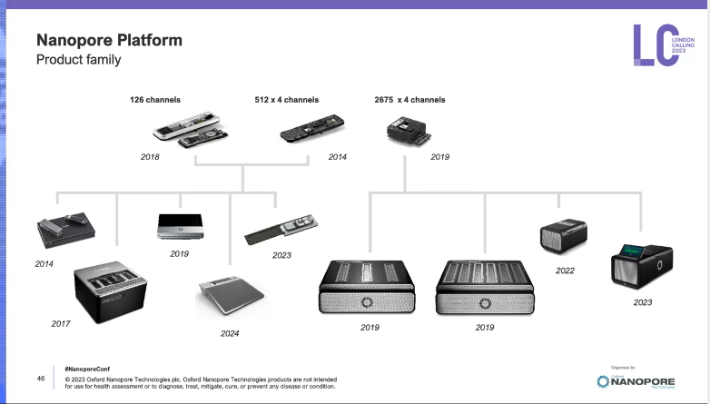

PromethION 2 solo
MinION Mk1B
MinION Mk1C
Flongle
PromethION 2
PromethION P24/P48
GridION
MinION Mk1D
Credit: Slide from Oxford Nanopore’s London Calling 2023

Slide 6
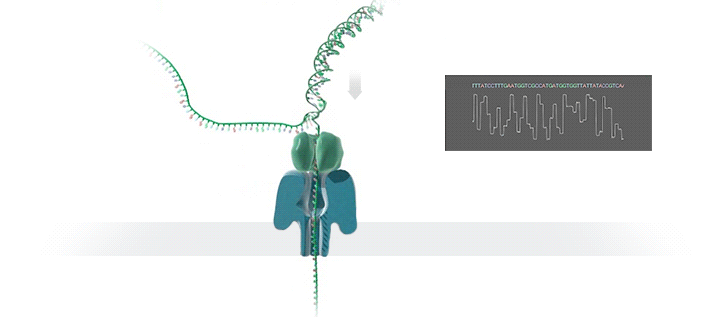
How does it work?
Image: Oxford Nanopore Tech
Notes:
During sequencing the nanopore analyses the entire fragment that’s presented to it- so the read length is deirectly related to the length of DNA/RNA in sample
Direct sequencing of individual DNA or RNA molecules without the need for PCR amplification or fragment cloning
The Motor protein (helicase) is provided on a leader adapter that is introduced to the end of the double-stranded DNA template, and unzips the double stranded DNA and present single strand template to the pore. It also controls the speed at which DNA passes through the pore (450bps).
The sequencing machine aasses a current across electrically resistant membranes into which protein nanopores are embedded
As DNA or RNA moves through the nanopore they cause disruption in the current which can be analysed to determine the sequence of bases

Slide 7
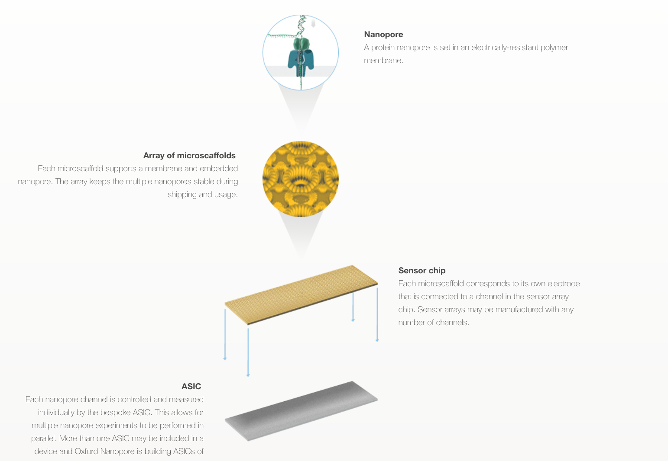
Flowcell: a closer look
Notes:
A MinION flowcell (promethion (bigger) and flongle (smaller) flowcells are different).
Nanopore embedded in membrane, in the sensor array
Ports to add priming mix (fuel for sequencing) and the sample library
Flowcell has an asic chip on the underside, which controls and reads signal data

Slide 8
Sequencing library preparation
Quality control
Fragmentation
End repair
Size selection
Amplification
Index/barcoding
Adaptor ligation
Quantification
Notes:
General steps to prepare a sequencing library- true for any next gen seq platform
Some steps are optional and dependent on the desired output e.g. you wouldn’t fragment if you want ultra-long reads, you might not amplify the DNA if you want to do metagenomic (untargeted) sequencing

Slide 9

Nanopore library preparation
Determined by
Input type (RNA, cDNA, gDNA, amplicon, metagenomic…)
DNA concentration (from picograms to nanograms)
Fragment length
Index/barcoding
If it needs to be field friendly (i.e. no cold chain)
Speed- does it need to be a rapid prep?
Image: Oxford Nanopore Tech
Notes:
Very much depends on your input material (type, concentration, size) and desired output.
Rapid library prep kits are very fast protocols but usually require higher input concentrations. They also work by a transposase method so will fragment your DNA.

Slide 10
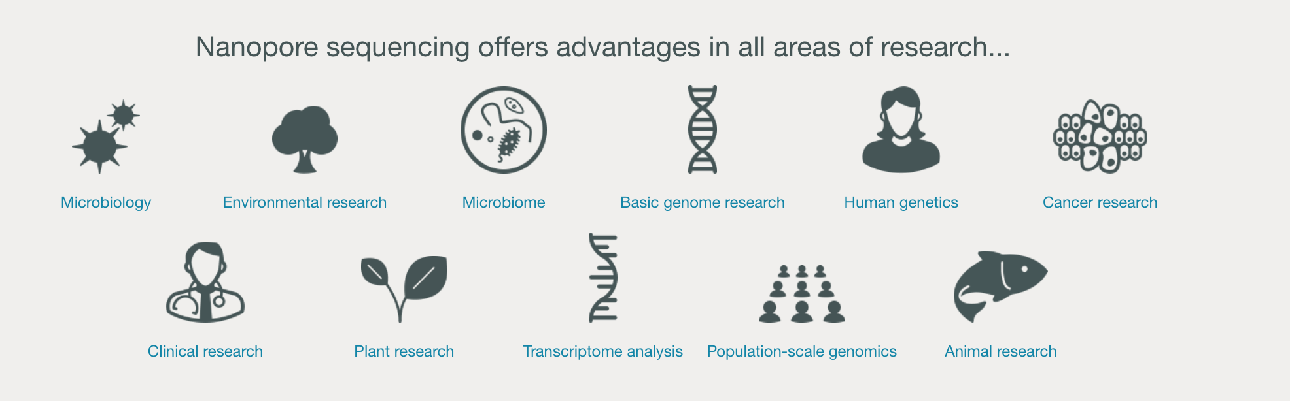
How it is being used
Image: Oxford Nanopore Tech

Slide 11
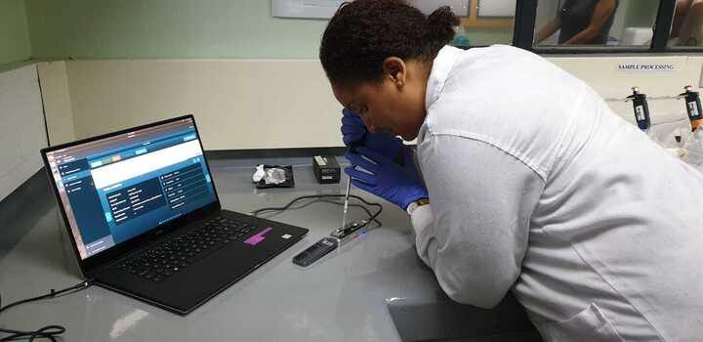
Advantages
Long reads
Real-time sequencing
Portability and accessibility
Single-molecule sequencing
Detection of base modifications
Wide range of applications
Continuous improvements

Slide 12
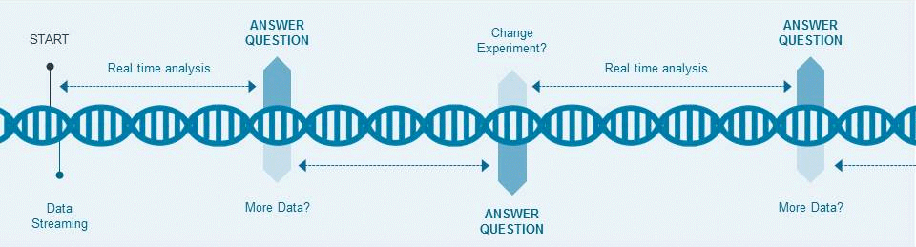
Real-time sequencing
Notes:
Ability to monitor and analyse DNA/RNA as it is being sequenced

Slide 13
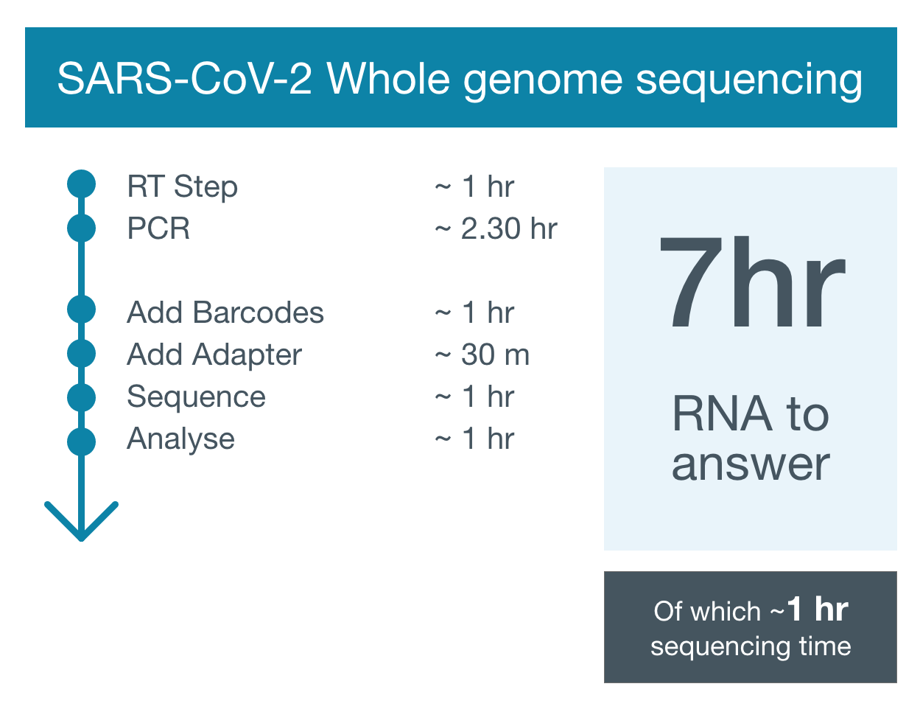
Notes:
One of nanopore’s greatest (and unique) advantages is real-time sequencing, which means you can get from sample to “answer” with super short turnaround times. This is of paramount importance in outbreak investigations or time-sensitive diagnostics (e.g. sepsis).

Slide 14

Long reads
Ultra-long reads (hundreds of kilobases)
Ease of assembly and improved quality
Span repetitive genomic regions
Structural variant detection
Notes:
Up to 950 kb
e.g. highly repetitive wheat genome sequencing in 2020
e.g. human genome studies structural variations and provided insights into their impact on gene expression and disease susceptibility

Slide 15
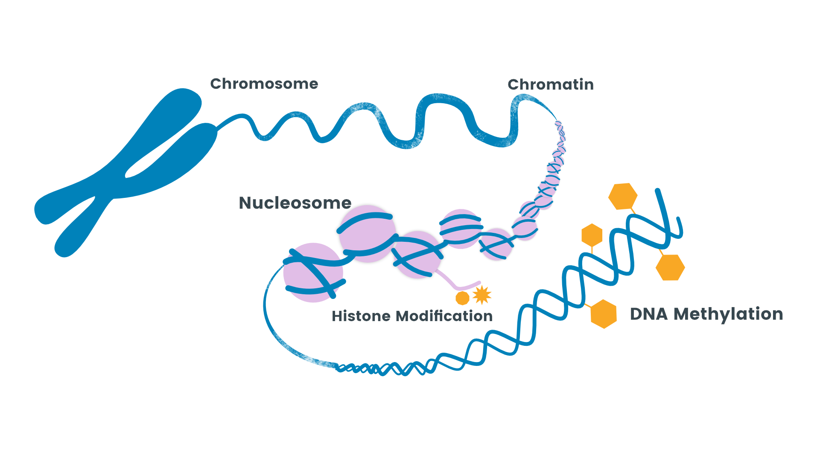
Detection of base modifications
DNA and RNA methylation
Can measure long-range epigenetic patterns
Genome-wide methylation studies!
Notes:
Heritable changes in gene expression that do not involve alterations in the underlying DNA sequence
- Methylation= addition of a methyl group (-CH3) to the DNA molecule
Important for regulating gene activity, development and different life stages
Patterns vary across cell types, developmental stages, response to environment
Can do genome wide methylation studies!

Slide 16
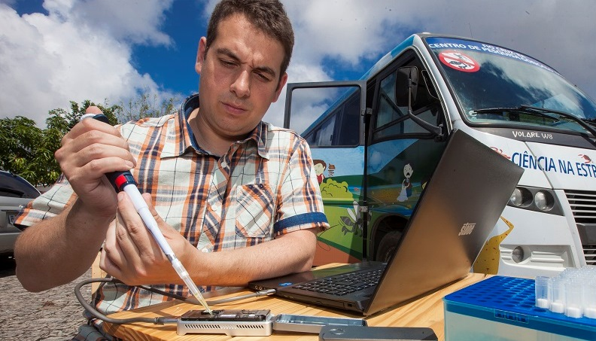
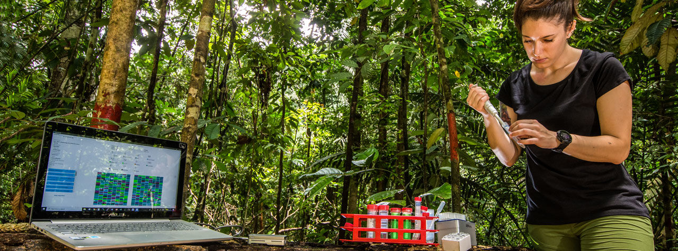
Portability and accessibility
Take the lab to the sample
Research & diagnostics in remote locations
Rapid, on-site sequencing
PHOTO: PIERRE ESCOUBAS/TAXON EXPEDITIONS 2018
Notes:
The main reason, I think, that people are using nanopore is its accessibility. Can buy a machine (minion) for $1000, which has opened doors for researchers all over the world. No longer need a super fancy lab to do this kind of work – disruptive technology!

Slide 17
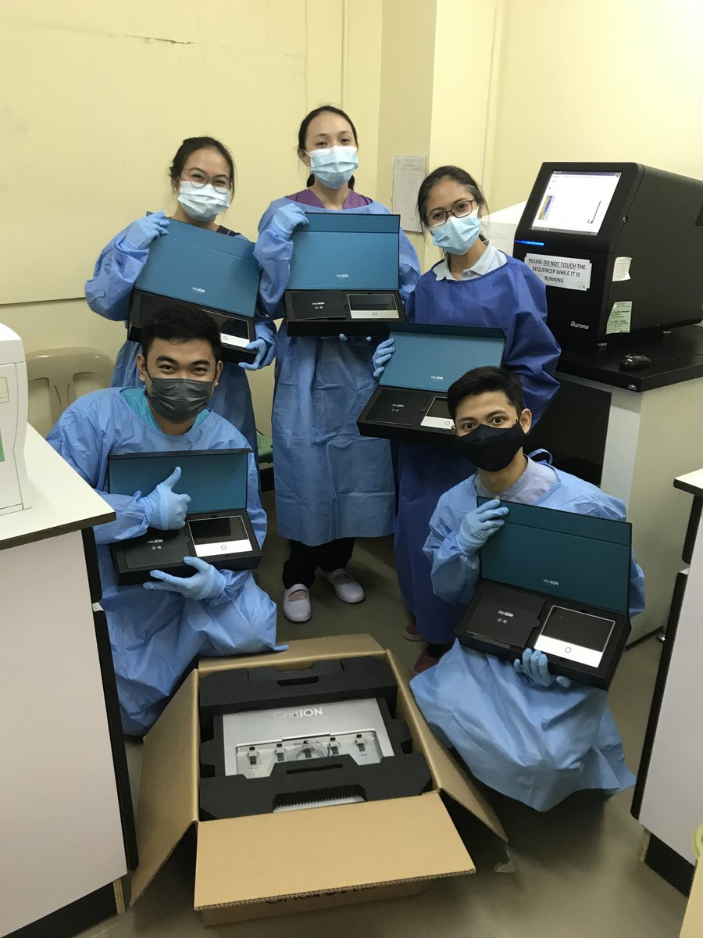
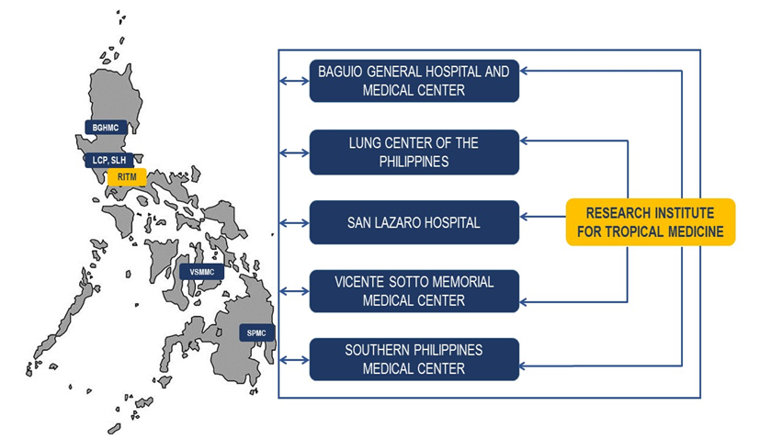

COVID – an explosion of decentralized sequencing capacity
Notes:
Nanopore really exploded during covid. It gave researchers in all corners of the globe access to sequencing capacity- even possible in low resource areas. Also extended capacity beyond main hubs, which was necessary during pandemic.

Slide 18
Disadvantages
Error rate
Insertion and deletion errors
Complex data analysis
Homopolymers
AGCTTTTTTTTCGCA
A | T | A | T | C | C | G | G | - | C | A | A
A | T | A | T | - | - | - | G | - | C | A | A
A | T | A | T | C | C | G | G | C | C | A | A
TCCTGAGTAATTA

Slide 19
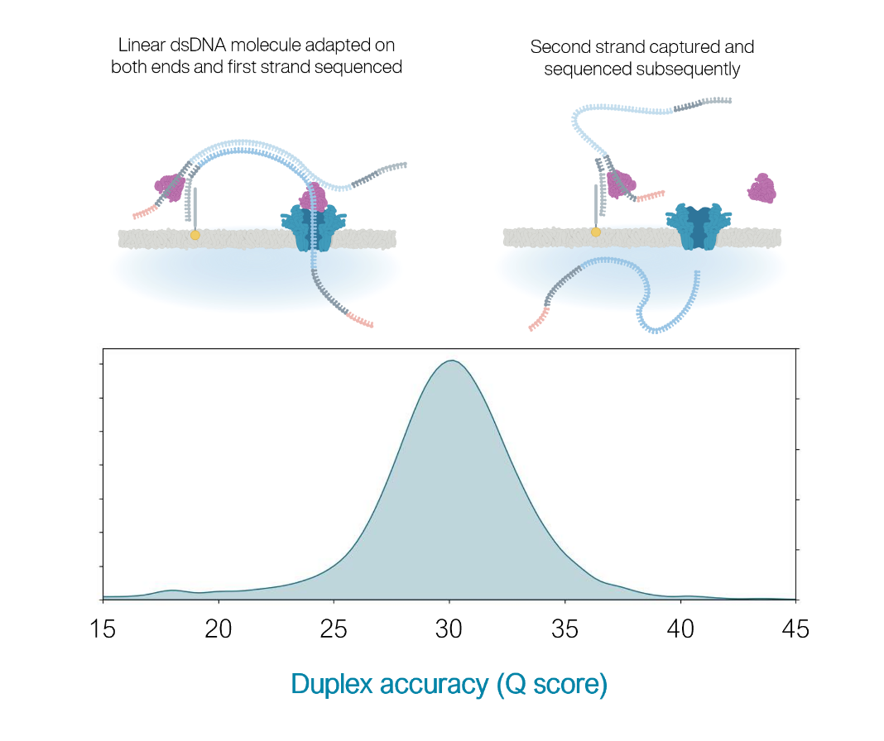
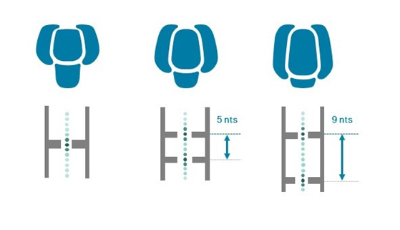
Latest kits/flowcells
Kit V14 chemistry with R10.4.1 flowcells
Higher accuracy and yield
Capable of duplex reads
R9.4.1
R10.3
R10.4.1
Image: Oxford Nanopore Tech
Notes:
R10 has a longer barrel and dual reader head, enabling improved resolution of homopolymeric regions and improving the consensus accuracy of nanopore sequencing data.

Slide 20
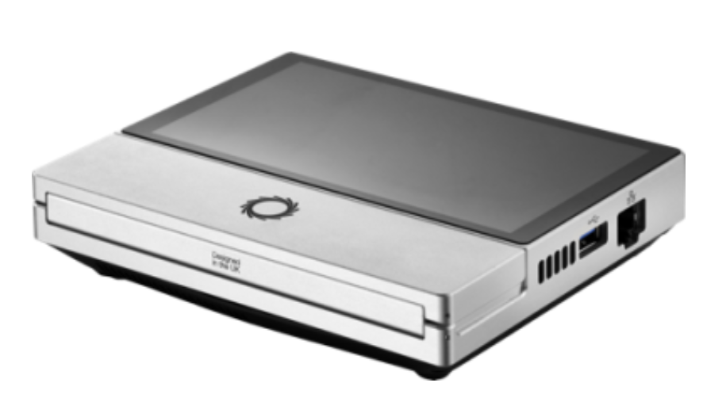
Products unavailable or being phased out
Kit 11 chemistry
R9.4.1 flowcells

Slide 21
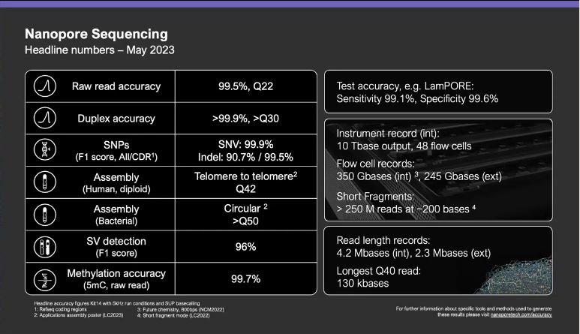
Credit: Slide from Oxford Nanopore’s London Calling 2023

Slide 22
Adaptive sampling
Ability to ”select” what passes through the nanopore
Avoid complex sample preparation
Provide a reference sequence(s) and choose to enrich or deplete any matches
Target
Non-target
Sample
Notes:
Also known as selective sequencing. An alternative to lab-based enrichment or depletion methods. These can be lengthy procedures in the lab, often need sample-specific adaptation and can bias the output data. Adaptive sampling is a software controlled enrichment method where the software basecalls the first few hundred bases of each read and compares it with the target reference sequences. Matching or unmatching sequences are rejected, depending on whether the software is set to enrich or deplete.

Slide 23
Target
Non-target
Real-time basecalling and alignment
ATGGATAATTGAG
Host
Eject DNA
Pore available to sequence other DNA
Notes:
Sequencing and alignment (to your provided reference) in real-time presents the opportunity to decide whether to continue allowing DNA to pass through the pore- or eject it
Ejecting an unwanted DNA fragment frees up the pore to sequence what you actually want. So you prioritise your target! Leads to higher yields in shorter timeframe.

Slide 24

Higher yields
Faster experiment
TCCTGAGTAATTA
Target
Continue sequencing

Slide 25
Caveats
More effective with longer reads
Faster pore decline
Need a good reference
Notes:
Trade off between read length and yield. Longer reads work better in adaptive sampling because there is more time to make a decision to eject or continue sequencing, and, freeing up the pore (from sequencing a long non-target DNA) has more of an impact to increase yield.
Some evidence suggests adaptive sampling causes a faster degradation of pores and more blockage of pore occurs, but seems to have improved.
Long, complex and repetitive reference sequences are difficult to use. Can take a long time to make a decision.

Slide 26

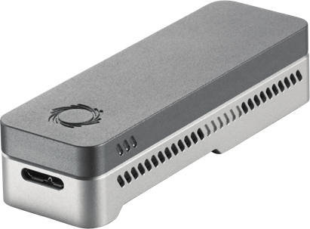
Recovery protocol
Recover a library from the flowcell and reload it on another flowcell!
Useful if:
Want more data from the same library
Library fails early in run
If flowcell is blocked
My precious
Notes:
Your sample may be very precious and you don’t want to risk losing it or not getting enough data from a flowcell. Can now ”recover” your sample from the flowcell if something goes wrong- and even redo the library prep!

Slide 27
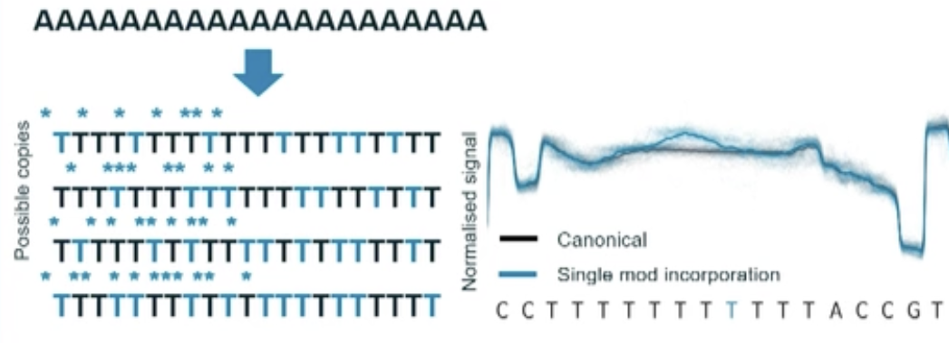
Homopolymer accuracy fix
Modifications to break up homopolymers (5B4)
Quality score improvements (92 to 99% at 90X coverage)
With polished assembly Q50
Notes:
Main type of error in nanopore sequence data
Moving from R9 to R10 improved

Slide 28
Fancy nanopore video!
https://nanoporetech.com/support/how-it-works#fullVideo&modal=fullVideo

Slide 29
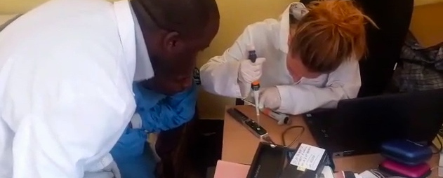
Let’s get sequencing!

